Slide 1
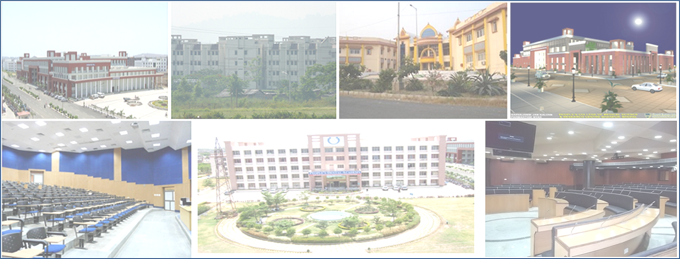
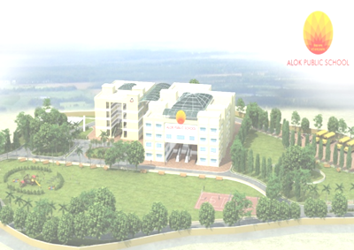
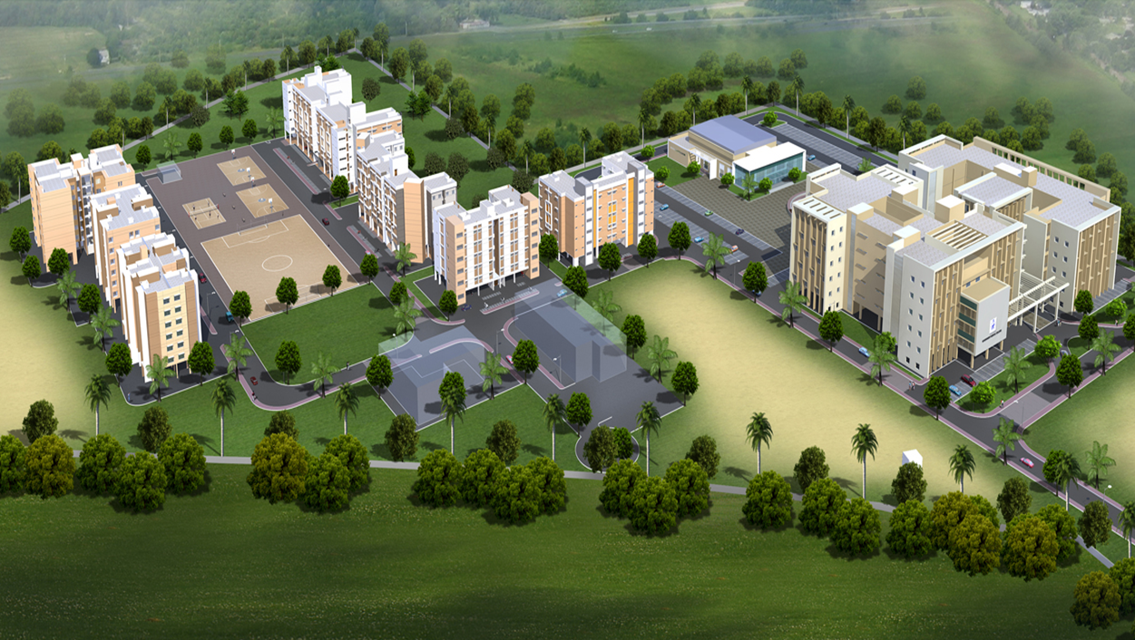
Transwat Techno-Engineering Services Ltd
[ Formerly Wadia Techno-Engineering Ltd ]
(Est. in 1960)
( INSTITUTIONAL PROFILE )
Design / Project Management Consultants for Highways, Bridges, Elevated Roads - Buildings (Commercial, Industrial, Institutional Buildings etc;)
- Major Irrigation (Reservoirs, Dams, Tunnels, Lift Irrigation, Canals) - Smart Cities - Water Supply - Industrial Parks - Logistic Parks
8-2-686/K/1&2, C-3, 2nd Floor,‘Kimtee Square’
Road No. 12, Banjara Hills, Hyderabad–500034 Tel : +91 40-23320233
Fax : 040-23384148 Email : bd@transwat.com; www.transwat.com

Slide 2
Index
Company Overview
Consultancy Services
Key Institutional Projects
Consultancy Services - Building Construction Sector
Consultancy Services – Hospital and Healthcare Projects
Consultancy Services – Hotels and Resorts
Consultancy Services – SEZ, Industrial Parks, IT Parks, Business/Exhibition Centers
Consultancy Services – Urban Engineering & Development RUIDP
Consultancy Services – Transport Sector
Consultancy Services – Industrial Projects
Key Clients
Contact
Transwat Techno-Engineering Services Ltd

Slide 3
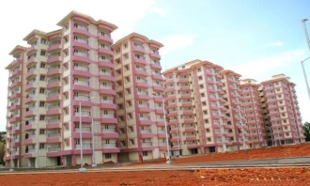
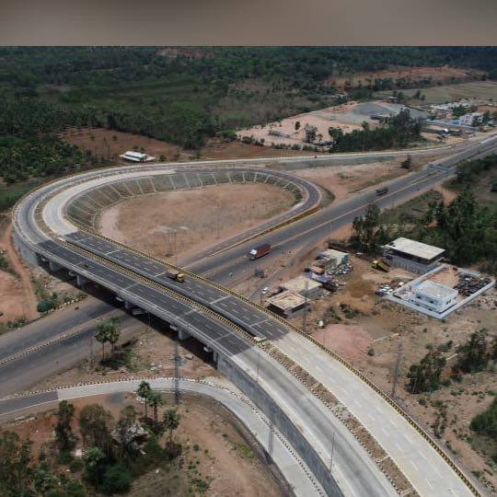
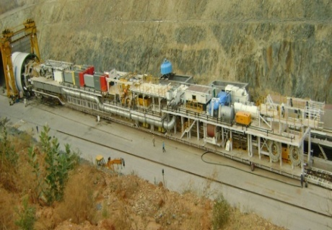
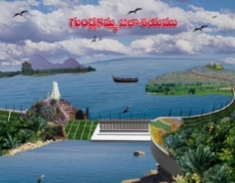
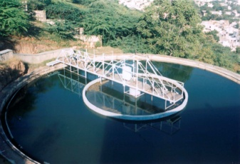
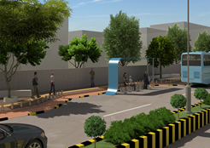
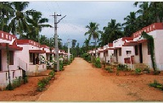
About Transwat Techno-Engineering Services Ltd (Formerly Wadia Techno-Engineering Services Ltd. )
Transwat Techno Engineering Services Limited, (TTESL), est. 1960, having Registered Office in Mumbai, has Completed consultancy for over 5000 projects on Pan India in the last 65 years, in varied sectors, viz., Transportation, Water, Buildings, Industrial, Logistics etc, has expertise & resources to offer consultancy services for various projects such as:
Buildings - Institutional such as Corporate Offices, University Buildings, Buildings for IITs, Medical College Campuses, Law College etc , Commercial Constructions, Multiplex Industrial Constructions, Residential Accommodations, Hospitals, Five Star Hotels, Recreational Infrastructure, Religious projects, and etc.
Transportation - Highways, Expressways, Elevated Roads, Fly over / ROBs, Major Bridges, City Smart Roads, Rigid Pavements, Logistic Parks, Utility Shifting Projects etc;
Major Irrigation Projects viz., Dams, Reservoirs, Canals, Tunnels, Lift Irrigation etc, Water Supply, Sewerage, Storm Water & associated infrastructure etc,
Urban Planning, Engineering, and Development right from the stage of Concept to completion, including extensive Urban Engineering Services for Water and Sanitation, Roads, Utilities, revamping of existing infrastructure & systems, Smart City Projects, Development of Parks, Environmental related Projects, etc;
Industrial Estate Development, SEZ, Industrial Parks, IT Park, Electronics Park, Textile Park, and etc;
Property Development Projects, etc,
Successfully completed consultancy for BOT / PPP Projects as also for various externally funded projects such as World Bank Projects, ADB Projects etc.
3
Formerly Wadia Techno-Engineering Services Ltd
Transwat Techno-Engineering Services Ltd

Slide 4
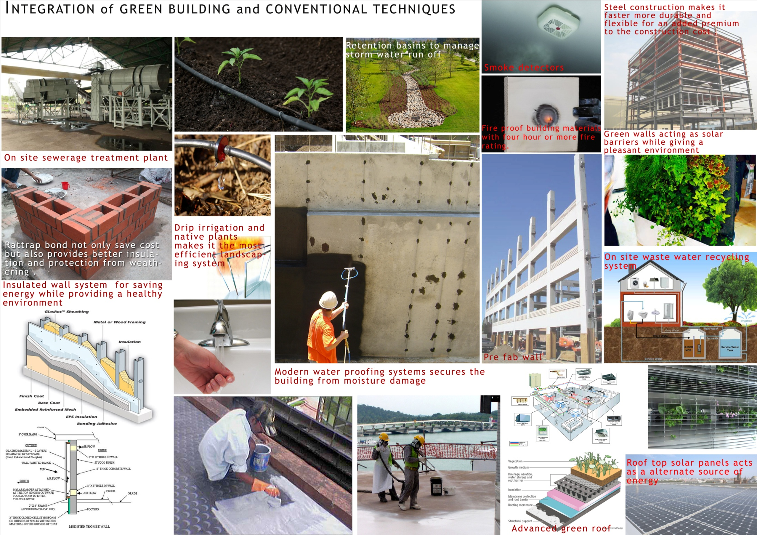
GREEN RECOMMENDATIONS as IGBC Founder Member
4
Wadia Techno-Engineering Services Ltd
Transwat Techno-Engineering Services Ltd

Slide 5
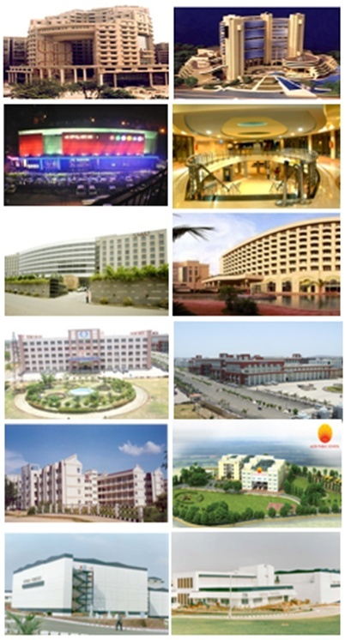
Consultancy Services –Commercial, Residential Buildings and other sectors
Preparation of Master Plan, Detailed Design Engineering, Drawings & Estimates, Tendering process, Bid Evaluation, Project Management Consultancy, Third Party Quality Control / Assurance, Value Engineering, Technical Audit
Financial Institutions and Corporate Sector
Commercial Centers (with Multi-Plex)
Hotels, Tourism & Entertainment sectors
Hospitals and Health Care sector
Educational Institutions Sector
Township Planning and Housing Sector
Transwat Techno-Engineering Services Ltd

Slide 6
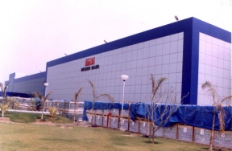
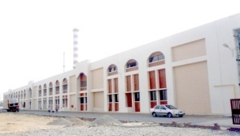
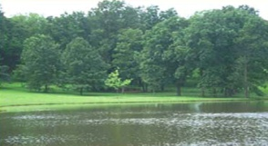

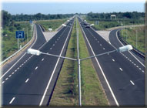
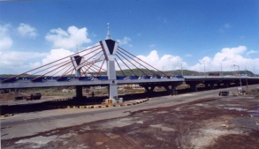
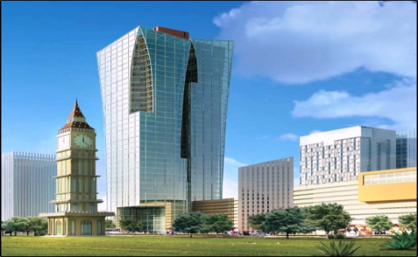
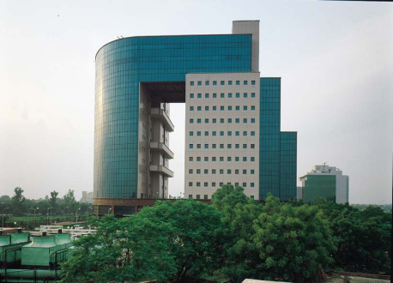
Consultancy Services - Other areas - Infrastructure
Preparation of Master Plan, Detailed Design Engineering, Drawings & Estimates, Tendering process, Bid Evaluation, Project Management Consultancy, Third Party Quality Control / Assurance, Value Engineering, Technical Audit
Industrial Projects
Water and Sanitation
Major and Minor Irrigation
Highways, Bridges, Rural Roads
SEZs, Industrial Parks, IT Parks
Special Projects
Transwat Techno-Engineering Services Ltd

Slide 7
Consultancy Services – Educational Institutions Sector
Preparation of Master Plan, Detailed Design Engineering, Drawings & Estimates, Tendering process, Bid Evaluation, Project Management Consultancy, Third Party Quality Control / Assurance, Value Engineering, Technical Audit
Colleges and Universities
Medical College Complex
Professional Institutions like IIT
Public Schools
Training Centres,
Educational Infrastructure Projects
Transwat Techno-Engineering Services Ltd

Slide 8
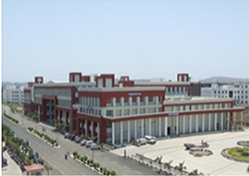
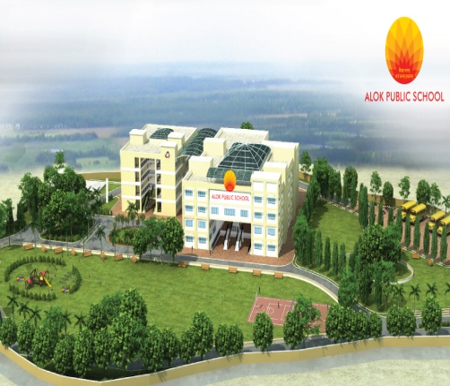
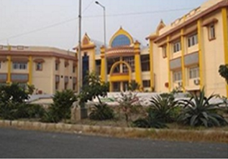
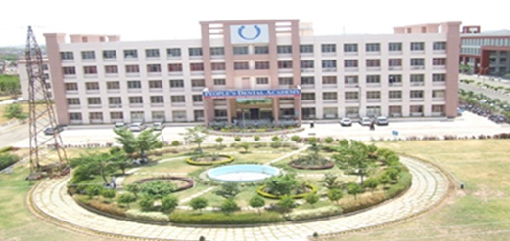
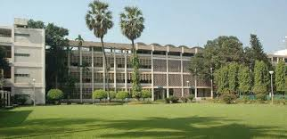
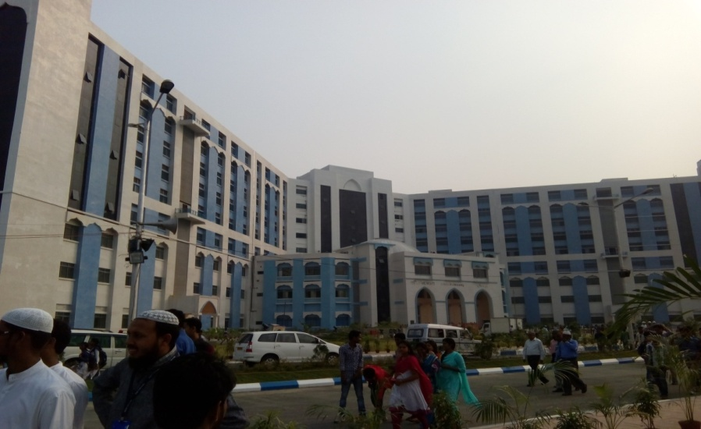
Consultancy Services - Educational Institutions Sector – Projects / Clients
SJPN, Bhopal
ALOK PUBLIC SCHOOL Silvassa, Gujarat
CHANAKYA NATIONAL LAW UNIVERSITY
PEOPLE’S COLLEGE OF DENTAL SCIENCE AND RESEARCH BHOPAL, MADHYA PRADESH
INDIAN INSTITUTE OF TECHNOLOGY BOMBAY
ALIAH UNIVERSITY CAMPUS
Expertise available for MASTER PLANNING, ARCHITECTURAL PLANNING & DESIGN, LAND SCAPE DESIGN, STRUCTURAL DESIGN, UTILITIES DESIGN, DETAILED DRAWINGS & COSTING, TENDERING PROCESS, PROJECT CO-ORDINATION, CONSTRUCTION SUPERVISION, DUE DELIGENCE, TECHNICAL AUDIT, PROJECT MANAGEMENT CONSULTANCY
Transwat Techno-Engineering Services Ltd

Slide 9
Key Institutional Projects
Transwat Techno-Engineering Services Ltd

Slide 10
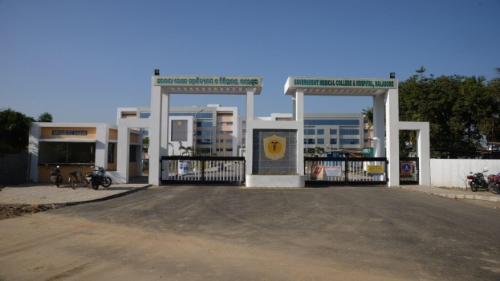
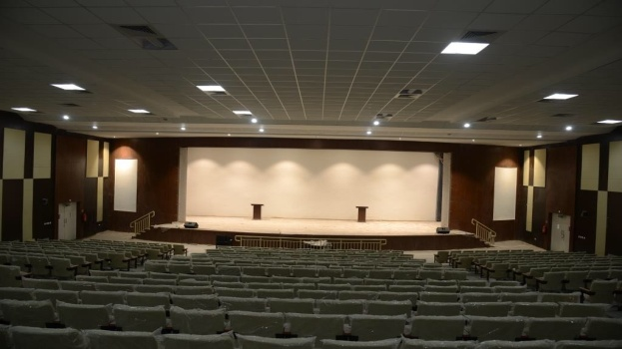
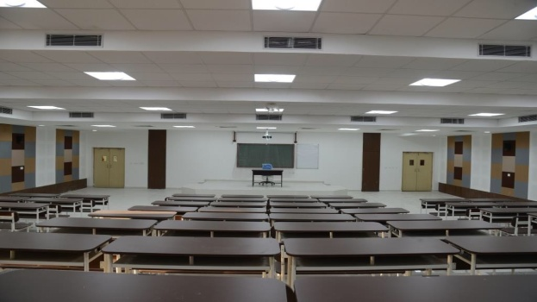
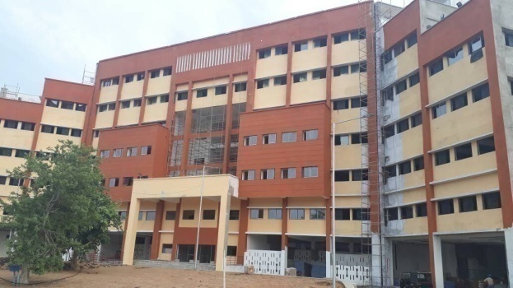
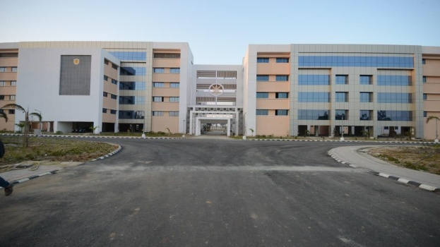
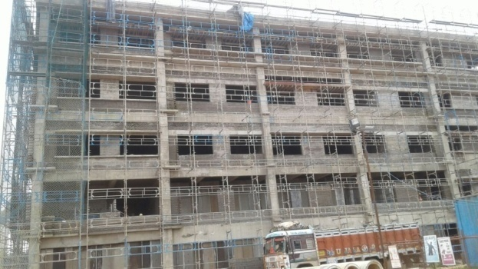
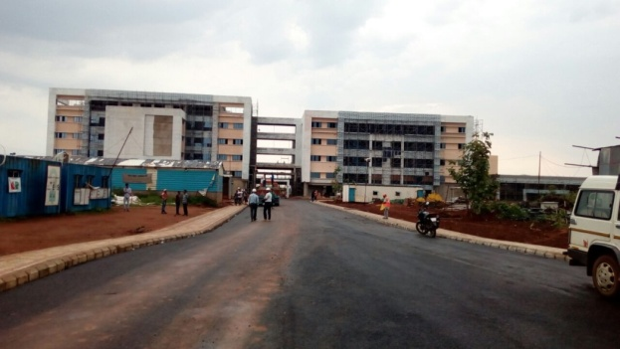
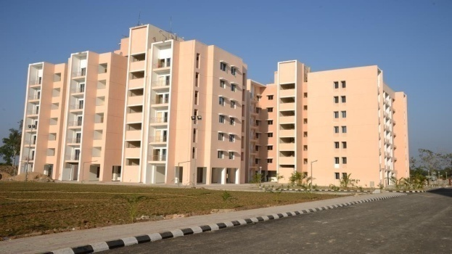
BUILDINGS Sector – New Govt. Medical College Campuses (5 NO’s)
Balangir Medical College
- Built Environment
Koraput Medical College
Total Built up Area of 5 Medical College Campuses
- over 280,000 Sq. Mtrs
Puri Medical College
Baripada Medical College
Balasore Medical College
10
Transwat Techno-Engineering Services Ltd

Slide 11
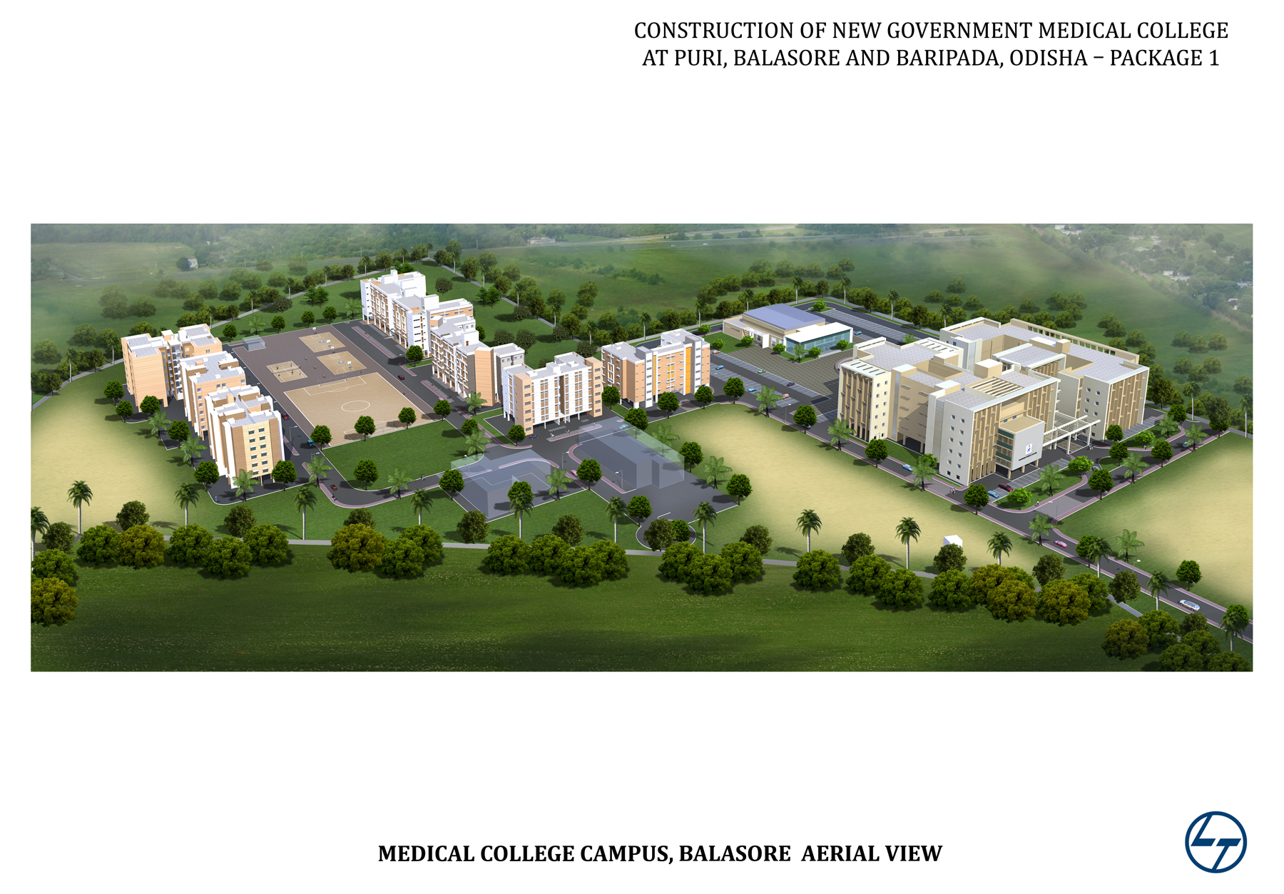
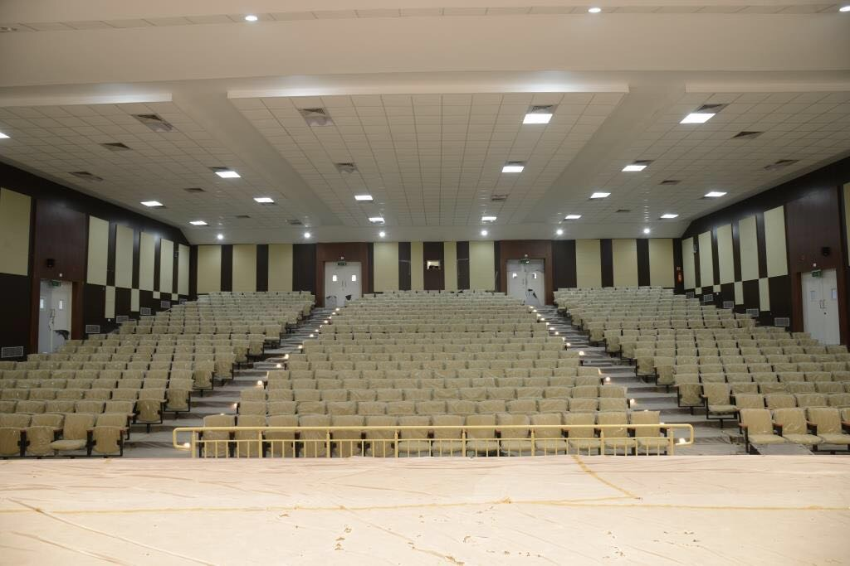
TYPICAL MASTER PLAN of CAMPUS - NEW GOVERNMENT MEDICAL COLLEGE CAMPUS IN OSIDHA (5 NO’s)
Typical Area Statement (As per MCI Norms)
S.No. | Building Type | Area in sqm | No. of Stories
A. | COLLEGE BUILDINGS
1.a. | Admin. Office & Teaching Facilities | 12912 | Stilt+5
1.b. | Department Block | 10158 | Stilt+4
2 | Auditorium - 650 Seats Capacity | 2875 | G+1
3 | Gymnasium | 104 | 1
4 | Autopsy Block | 647 | 1
5 | Animal House | 206 | 1
B. | HOSTEL BUILDINGS (ALL WITH STILT)
1 | Boys Hostel – 300 Students Capacity | 5940 | Stilt+5
2 | Girls Hostel – 150 Students Capacity | 3960 | Stilt+5
3 | Interns Hostel – 100 Students Capacity | 1980 | Stilt+5
4 | Resident Doctors Hostel – 100 Students Capacity | 3480 | Stilt+5
C. | RESIDENTIAL BUILDINGS (WITH STILT)
1 | 4R Flat –Teaching Staff Quarters | 3900 | Stilt+6
2 | 3R Flat-Teaching Staff Quarters | 5640 | Stilt+6
3 | 2R Flat- Non Teaching Staff Quarters | 4320 | Stilt+6
D. | SERVICE BUILDING
1 | Service Building | 750 | B+1
TOTAL AREA (Sq. Mtrs) |  | 56872
Auditorium - 650 Seats Capacity
Entire Campus provided with appropriate Fire Fighting, PA, Safety and Security Systems, Connected with secured Wi-Fi, etc
11
Transwat Techno-Engineering Services Ltd

Slide 12
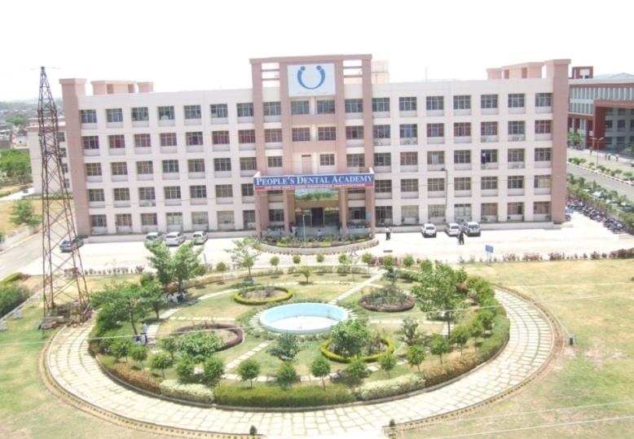
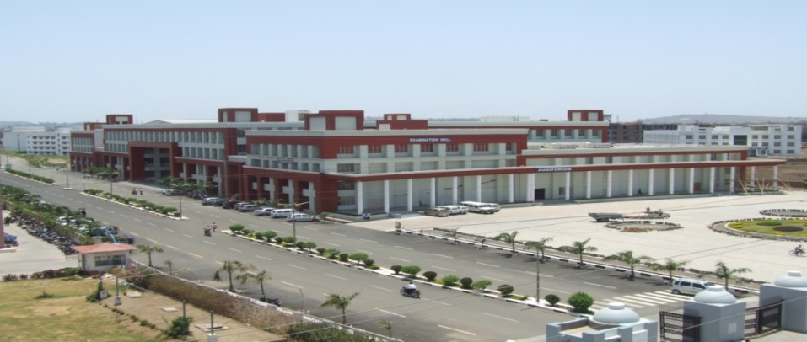
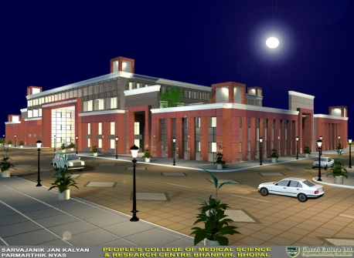
SJPN/People’s Group’s MEDICAL COLLEGE, TEACHING HOSPITAL, DENTAL COLLEGE, NURSING COLLEGE, PHARMACY, PHYSIOTHERAPY & CATERING COLLEGE COMPLEXES developed in a phased manner with
World Class Infrastructure
Long Term Consultancy services provided for phased manner development: MASTER PLANNING, ARCHITECTURAL PLANNING & DESIGN, STRUCTURAL DESIGN, UTILITIES DESIGN, CO-ORDINATION, DETAILED DRAWINGS & COSTING, TENDERING PROCESS, CONSTRUCTION SUPERVISION AND PROJECT MANAGEMENT CONSULTANCY
People’s Medical College Complex for 150 MBBS Admission, including College Building, Hostels, Residential Quarters, Auxiliary Blocks and Site Development as per MCI Guidelines; Built-up Area: 8.0 Lakhs SFT 750 Bedded Teaching Hospital as per MCI Guidelines; Built-up Area: 5.0 Lakhs SFT People;s Dental College Academy Complex for 100 BDS Admission including College Building, Hostels, Residential Quarters, Auxiliary Blocks and Site Development as DCI Guidelines; Built-up Area: 2.0 Lakhs SFT People’s Nursing College Complex for 100 Admission including College Building, Hostels, Residential Quarters, Auxiliary Blocks and Site Development as INC Guidelines; Built-up Area: 1.25 Lakhs SFT People’s Pharmacy, Physiotherapy and Catering College for 60 Admission including College Building and Hostels; Built-up Area: 1.75 Lakhs SFT
Total Built-up Area: 18 Lakhs SFT
Transwat Techno-Engineering Services Ltd

Slide 13
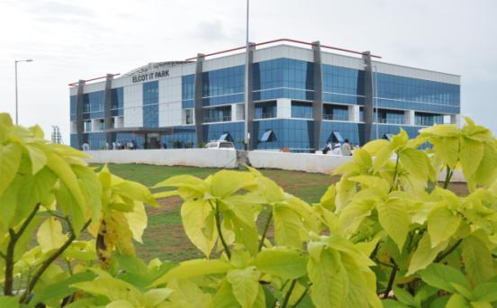
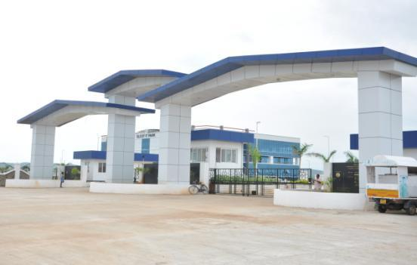

An Integrated Information Technology (Special Economic Zone)
Tirunelvelli, Salem & Hosur, Tamilnadu
Client Name: Electronics Corporation Of Tamil Nadu (Elcot)
Total built-up area: 873 Acres
Services Provided:
Layout Plan
Master Planning,
Project Structuring,
Design & Tendering
Key Features:
Consultancy Services for the development of modern Integrated Information
Technology Special Economic Zone at Tirunelvelli, Salem & Hosur of 500 acres,
164 acres and 173 acres respectively in Tamil Nadu. The scope of works
includes Geological Survey and Contour Survey of the Layout, Architectural
design including internal layout, Structural Design, Design of sanitary,
plumbing, drainage, water supply and sewage works, Electrical Design and
Project Management Services.
Completion year: 2018
Project cost: Rs. 700 Crores
Transwat Techno-Engineering Services Ltd

Slide 14
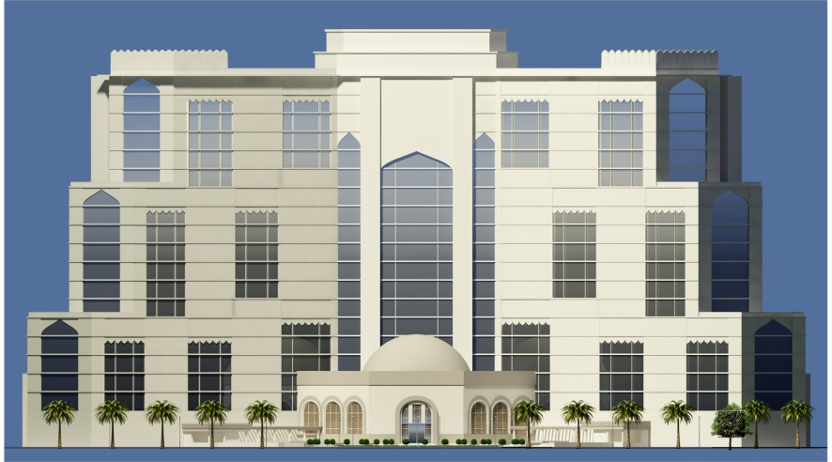
ALIAH UNIVERSITY CAMPUS
Kolkata, West Bengal
Completion year: 2016
Project cost: Rs. 221 Crores
Client Name: Hooghly River Bridge Commissioners
Services Provided:
Detailed Project Report Master Planning Detailed Architectural Planning Structural Design Electrical Design Water Supply Design Fire fighting system Sewerage & Plumbing HVAC Landscape work Approval from all Statutory Bodies
Key Features:
Architectural Planning, structural design, along with all infrastructural amenities including roads and pathways, drainage, water supply, sewerage, electrical works, fire fighting system, landscaping and beautification etc. for G+8 Storied Aliah University
Total Land Area: 25 Acres.
14
Transwat Techno-Engineering Services Ltd

Slide 15
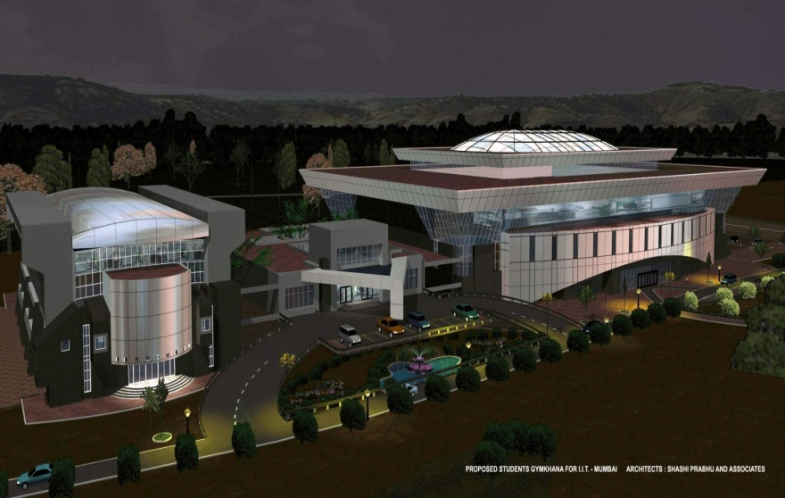
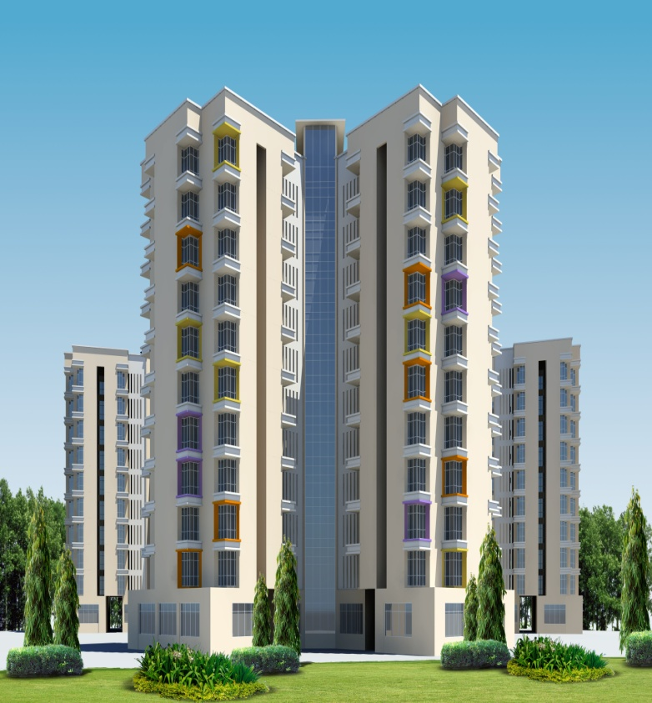
Services to IIT Mumbai
IIT Mumbai
Modern Students’ Gymkhana at it’s 300-acre campus at Powai – Mumbai. This project includes construction of new building for indoor facilities for sports and cultural activities and also up gradation / modification of existing sports gymkhana, fields, courts and grounds;
Services include Project Management services including Development of the conceptual framework for the project, Overall Supervision and Management of the Project, Preparation of Facilities requirement Schedule, Preparation of Cost Effective Proposal, Formulation of Detail Execution Survey, Proof checking the Architectural and Utilities drawings.
Construction of hostel building block no 15 & 16 (G+10) including internal public health works, internal road works, electrical works and its associated works for IIT(B), Powai
There are 3 wings of G+10 floors each for two buildings and all 3 wings are placed in such a manner, which forms common enclosed space for the student.
Special care has been taken for physically handicapped students;
Common amenities like T.V room gymnasium, indoor games etc. planned at ground floor level.
Total built up area: 4, 94,000 Sq. ft
Description of actual services provided by our company:
Construction Management and Construction Supervision Consultancy Services
Transwat Techno-Engineering Services Ltd

Slide 16
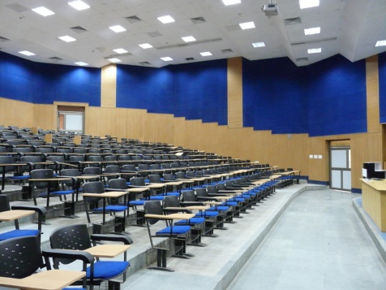
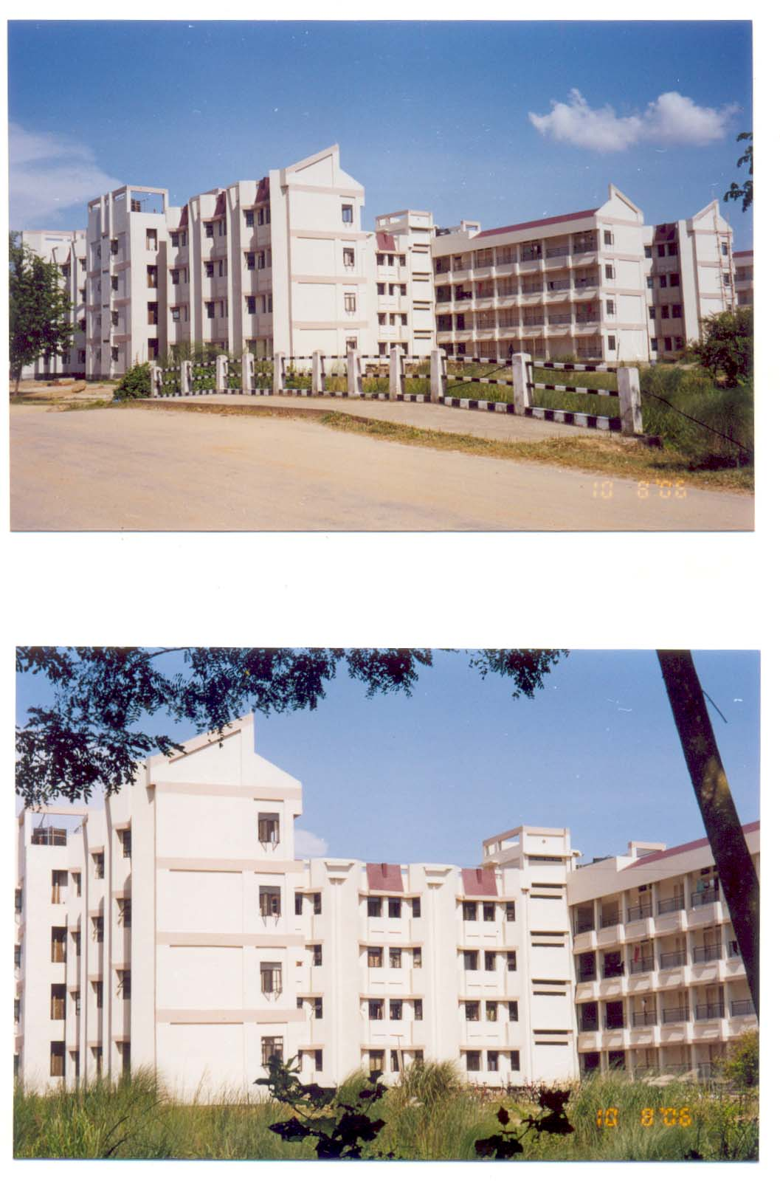
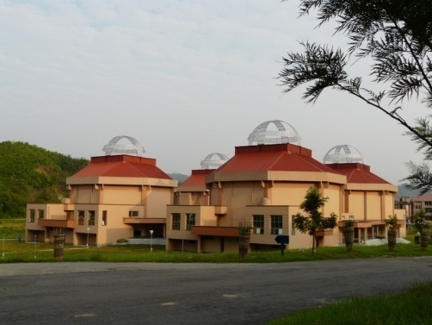
Services to IIT Madras, IIT Guwahati
IIT Guwahati
Planning and design of Lecture Hall Complex (1000 capacity) including utility system;
Planning and design of 500 capacity students’ Hostel Block, including utility system, inter- modal transport facilities, surface parking, compound wall, internal roads, with other Ancillary Blocks
Services include Architectural Planning and design, Structural Planning and design, Utility Planning and designing, Preparation of layout plan and working drawing, Detailed Estimates, Preparation of tender documents, Occasional supervision of construction
IIT Madras
1) Additional class rooms for Mechanical Science Block The building was designed for 12 Rooms to accommodate 180 students with Three Gallery type rooms at Ground Floor;
Services include Architectural Scheme and Detailed Architectural Planning, Design and Drawings.
Structural Scheme and Detailed Structural Design and Drawings, Electrical ,Occasional Site Visit.
2) Miscellaneous Buildings such as Gas Dynamic Laboratory, Warden Office, Gate Office, Parking, Swimming Pool etc.
Services include Concept Planning, Architectural Design, Structural Design, Internal Electrification
Central Library Block with basement, Ground Floor and Mezzanine Floor, First & Second Floors, taken up in two stages, with a stack volume upto 2,50,000 with a total area of 6515 Sq.M. (This assignment was awarded after having won architectural competition)
Services include Concept Planning, Architectural Scheme and Detailed Architectural Planning, Design and Drawings, Structural Scheme and Detailed Structural Design and Drawings, HVAC Services, Fire Fighting System, Plumbing and Sanitary, Internal Electrification, Occasional Site Visit;
Transwat Techno-Engineering Services Ltd

Slide 17
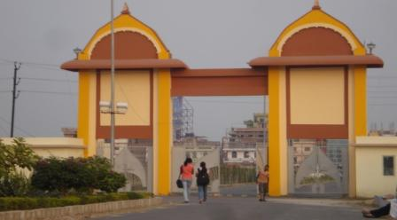
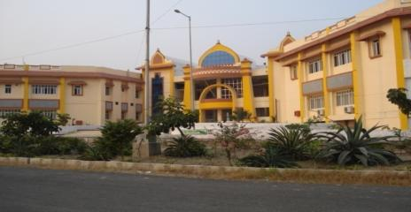
Chanakya National Law University
Patna, Bihar
Infrastructure comprising of : Academic Building Girls Hostel Boys Hostel Library, Faculty Guest House VIP Guest House Vice Chancellor Residence Registrar Residence
Consultancy services provided: Feasibility Studies, EIA / R&R Studies, Master Planning, Architectural Planning, Structural Design, Utility Design, Landscape, Detailed Drawings & Costing, Project Co-ordination & Management
Completion year: 2012
Project cost: Rs. 82.39 Crores
Built-up Area: 46,337 m²
Transwat Techno-Engineering Services Ltd

Slide 18
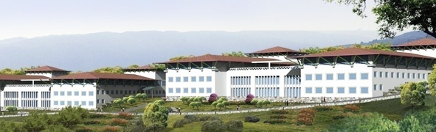
Services to IISER Campus
Client Name: Indian Institute of Science Education & Research
Location: Vithura, Thiruvananthapuram, Kerala
Total built-up area: 6,50,000 sq.ft.
Services Provided:
Project Management Consultancy Proof checking of Designs and Drawings Construction Supervision
Key Features:
Development of campus consist of Academic Complex, Residential Buildings, Dining Halls, Sports complex, students activity centre, food court, etc. and infrastructure development for the total area of about 200 acres for Science Education Research Institute, Phase-I at Vithura, Thiruvananthapuram.
Project cost: 253 Crores
Transwat Techno-Engineering Services Ltd

Slide 19
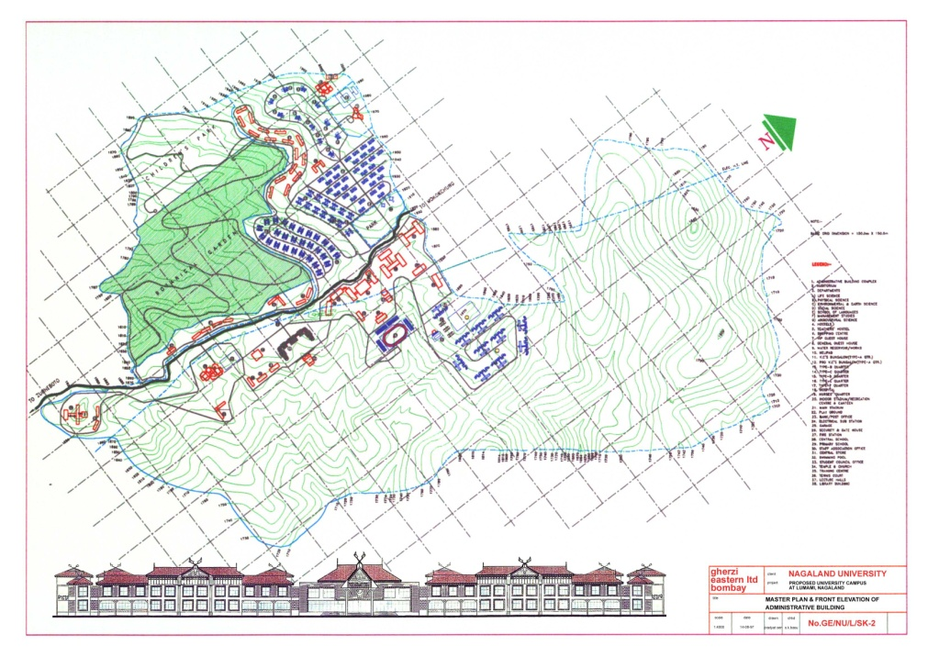
Campus Development for University of Nagaland
Lumami, Nagaland
Client Name: University of Nagaland.
Services Provided:
Master Planning
Site Development,
Architectural work and Development
Structural engineering work
Preliminary cost estimate
Water supply and Water Treatment Plant
Sanitation and Drainage and Effluent Disposal Treatment
Internal & External Electrical Works
Air Conditioning and Ventilation (HVAC)
Fire Fighting and Landscaping
Key Features:
The objective of Nagaland University was to disseminate advance knowledge by providing institutional and research facilities to the students.
The University intended to execute the Master Planning, preliminary & detail engineering design and associated consultancy work for setting up a full fledged academic institutional complex with Academic buildings, Administrative buildings, Housing, Hostels and all the necessary amenities as required for such complex along with all the internal and external infrastructure thereof.
The site was a hilly terrain with approx. area of 802 acres.
Completion year: 2002
Project cost: Rs. 50 Crores
19
Transwat Techno-Engineering Services Ltd

Slide 20




ALOK PUBLIC SCHOOL
AT VILLAGE SAYLI, SILVASSA, DNH.
Infrastructure comprising of : Academic Building Boys Hostel Library, Faculty Guest House VIP Guest House Vice Chancellor Residence Registrar Residence
Consultancy services provided: Feasibility Studies, EIA / R&R Studies, Master Planning, Architectural Planning, Structural Design, Utility Design, Landscape, Detailed Drawings & Costing, Tender Processing and Bid Evaluation, Project Co-ordination & Management, Quality Audits, Contract Administration
Transwat Techno-Engineering Services Ltd

Slide 21


COLLEGE OF FISHERIES CAMPUS,
AGARTALA, of Central Agricultural University
Infrastructure comprising of : Academic Building Boys Hostel, Girls Hostel, Library, Laboratories Auditorium, Staff Housing Market, Post Office, Bank and allied infrastructure
Consultancy services provided: Feasibility Studies, EIA / R&R Studies, Master Planning, Architectural Planning, Structural Design, Utility Design, Landscape, Detailed Drawings & Costing, Project Co-ordination & Management
Built-up Area: 14,880 M²
Transwat Techno-Engineering Services Ltd

Slide 22


Morarji Desai Residential School Complexes (MDRS)
Kittur Rani Chennamma Residential School Complexes (KRCRS),
Ekalavya Model Residential School Complex (EMRS),
Hostels for Rural Meritorious SC / BC / Minorities & ST Students
SECTOR EXPERIENCE – EDUCATION
Client Name: Karnataka Residential Educational Institutions Society, Bangalore
Location: Over 20 Different Urban / Rural areas of Karnataka
Services Provided:
Concept Design Architectural Planning & Design Structural Design Utilities Design Project Management & Supervision
Key Features:
Residential School Complexes and Hostel Buildings of Social Welfare Department in rural parts of Karnataka for rural meritorious SC/BC/Minorities and ST students. Each building to be constructed in 10 acres of land and Rs.5 Crores for MDRS/KRCRS) / Rs.10 Crores for EMRS is the app. project cost for each complex. Total over 20 Residential school complexes in different parts of Karnataka.
Transwat Techno-Engineering Services Ltd

Slide 23


Third Technician Education Project India, Meghalaya / Nagaland For State Project Implementation Unit Directorate of Higher & Technical Education, Meghalaya / Nagaland (World Bank assisted project)
Third Technician Education Project India, Meghalaya
(State Project Implementation Unit Directorate of Higher & Technical Education, Meghalaya)
Admn & Academic Building, Boys & Girls hostel, Staff Quarters, Workshop & Amenity Centre at Tura - Plot Area: 19.77 Acres. Built – up Area: 8,961 sq.m.
Administrative & Academic Building, Boys & Girls hostel, Staff Quarters, Workshop at Jowai. Plot Area: 11.74 Acres. Built – up Area: 9,478 sq.m.
Administrative office building.
Third Technician Education Project India, Nagaland
(State Project Implementation Unit Directorate of Higher & Technical Education, Nagaland)
Institute of Communication Technology MKK. Plot Area: 35 acres. Built – up area: 5084 sq. m.
Khelhose Polytechnic, Atoizu. Plot Area: 29 acres. Built – up Area: 7730 sq.m.
Govt. Polytechnic, Kohima. Plot Area: 15 acres. Built – Area: 4230 sq.m.
Directorate of IT & TE, Kohima.
Services Provided for above projects:
* Topographical Survey * Preparation of Master plan * Detail Architectural, Structural & Utility Planning * Detail Utility layout for the entire campus * Detail Planning of Campus Landscaping and arranging detail plantation of the area to upgrade environmental condition of the local areas * Bidding Process
* Evaluation of tenders and Organising construction work for various buildings, systems & utilities * Supervising total activity, individual construction works * Advising clients on Technical and Commercial actions to be taken for fulfilling the task sof the project * Technical Audit, Value Engineering, PMC Services
Transwat Techno-Engineering Services Ltd

Slide 24










Consultancy Services - Building Construction Sector
First International Finance Centre, Mumbai
Tamil Nadu Police Academy – Admn. Building
Grand Hyatt – 5 Star Deluxe Hotel Mumbai
Statesman House, New Delhi
DG MAP - Director General
Married Accommodation Project
Municipal Corporation of Delhi Civic Centre
Naparel Towers, Mumbai
ICICI Bank, Mumbai
Delhi Metro Rail Corporation Building
National Stock Exchange
MTNL Regional Telecom Training Center and Hostel Building
Transwat Techno-Engineering Services Ltd

Slide 25



Consultancy Services - Building Construction Sector
Aliah University Campus New town Rajarhat West Bengal / 87331 Sq Mtrs / Rs 236 Crs
Consultancy in Buildings Sector – Master Planning, Land Scape, Detailed Designs, Drawings, BoQs, PMC, Green Building Concept etc
OFFICE COMPLEX AT KKNPP – NPCIL, Koodankulam, TN / 40,563 Sq Mtrs
Delhi Metro Rail Corporation Building
Res .Accom. 255 quarters
25
Transwat Techno-Engineering Services Ltd

Slide 26


Consultancy Services – Township and Housing Projects
Director General Married Accommodation Project , Government of India
Total number of dwellings: 15832 units - Phase I &II (Mumbai, Pune, Nashik, Ahmednagar, Lonavala, Goa, Karwar, Vizag, Kochi & Portblair , Delhi, Ferozpur, Amritsar, Bathinda )
Services Provided:
Topographical Survey Master Planning Architectural Designing Structural Detailing | Utility Designing Project Management Construction Supervision
Key Features:
The Ministry of Defense has proposed the construction of residential accommodations for Defense personnel at various location in the country The proposed structures are G+1, G+2, G+3 and multi-storied in some locations.
Client Name: National Peroxide Limited
Project Name : Naperol Tower
Location: Mumbai, Maharashtra
Project Brief: Stilt + 29 storied building having 187 flats 50 flats of 3 BHK 137 flats of 2 BHK
Built Up Area: 21,680 M2
Services Provided
Architectural Planning and Designing Structural Designing Project Management
Transwat Techno-Engineering Services Ltd

Slide 27

First International Finance Center
Mumbai, Maharashtra
Client Name: Earnest Towers Pvt. Ltd. BUA: 439,094 sq.ft
Services Provided:
WTESL is Indian Design Architects to the Project
Provide information to KPF in relation to Development Control
Guidelines, material specification; propose alternative design
solutions for problem areas, etc.
Design Coordination, As built drawings., Quality control and check on site.
Architectural supervision. Block work and working drawings.
Design for finishes in service areas.
Checking and approval of GFC and shop drawings from vendor.
Key Features:
First International Finance Center will provide approximately 42,000 Sq.M of Grade-A office space, entered through double height pass through lobby. Extensive environmental features have allowed this project to receive LEED gold rating. The project features expansive floor plates accommodating numerous potential office layouts. The buildings North Facade, fronting the Bandra Kurla Complex Road, features an arcade delineated by a seemingly float White glass tube, which also defines the building podium and provide a terrace at 4th floor. The space beneath the tube feeds through to a pass through lobby which connects the pedestrian arcade to an automobile drop off area in the back.
Transwat Techno-Engineering Services Ltd

Slide 28
Other similar projects
Residential Training Centre of Indian Oil Corporation
M.T.N.L. Regional Telecom Training Centre
Police Academy at Oonamanchery, Kancheepuram
Kohima College (Mount Olive College), Kohima
Residential Hostel Building for PWD, Maharastra
Expansion of Modern Public School Society of Samtel Group
Laboratory Building for Centre of Plasma Physics, Guwahati
Staff Training Complex for Canara Bank, Bengaluru
Staff Training Campus for Union Bank of India, Mumbai
Training Centre for L & T (Switchgear Training Centre, Lucknow)
Regional Institute of e-Learning and Information Technology, Nagaland
Indian Institute of Foreign Trade Campus, Kolkata
Institute of Hotel Management and Catering Technology, Bengaluru
Transwat Techno-Engineering Services Ltd

Slide 29




Key Clients
Consultancy Services – Hospital and Healthcare Projects
Cancer Hospital, Mumbai
Research Centre, Delhi
Tata Memorial Cancer Hospital, Mumbai
Laboratory & Malaria Research Centre, New Delhi
Expansion of Hospital, Delhi
Hospital, Madhya Pradesh
Expansion of Indrapastha Apollo Hospitals, New Delhi
Hospital Bhopal
Transwat Techno-Engineering Services Ltd

Slide 30






Consultancy Services – Hotels and Resorts
Intercontinental The Grand, New Delhi
Intercontinental, The Grand Beach Resort Goa
Renaissance Resort, Goa
Hyatt Regency, New Delhi
Intercontinental The Grand, Mumbai
Aman Bagh Resort Hotel, Rajasthan
30
Wadia Techno-Engineering Services Ltd
Transwat Techno-Engineering Services Ltd

Slide 31

Grand Hyatt – 5 Star Deluxe Hotel Mumbai
Client Name : Seajuli Property and Viniyog Limited
SBUA: 1,10,000 sq.m.
Project Cost: INR 620 Crores
Services Provided:
Architectural (Post Design Development) & Structural Designing Proof Checking of HVAC, Electrical, Lift, IBMS, Security System, Fire Alarm, Audio-Visual & Telephone, Designing of Plumbing, Fire Fighting, Natural Gas Installation, Boilers, WTP, STP
Key Features:
• 651 Guest-Rooms &
95 Service suites
• 100,000 sq.ft. (9,290 m2) for Retail
• Food court , Regency club with
Board rooms, Health spa, Fitness
center, Business Centre and Pool
• Grand Ballroom (900 seats)
• Bar/Coffee shop (160 seats),
Café/Brasserie(100 seats)
• Parking for 780 cars (31,500 m2)
Transwat Techno-Engineering Services Ltd

Slide 32






Consultancy – SEZ, Industrial Parks, IT Parks, Business / Exhibition Centers
Platinum Plaza/ Platinum Park, Bhopal
Educational complex
Convention Center, Exhibition Hall & Service Building
ELCOT Park, Chennai (873 Acres)
Crystal IT Park, Indore (1,93,570 m2 )
Logix Park - Noida
Transwat Techno-Engineering Services Ltd

Slide 33




For Govt. of Andhra Pradesh | Third Party Quality Control Consultancy Services for Irrigation Projects in Andhra Pradesh
Irrigation & CAD Department
Govt. of Andhra Pradesh has taken up a massive construction programme in 2004-05, called “JALAYAGNAM”, of Major Irrigation Projects all over the State.
Large Scale Projects require multi-level construction supervision and quality control procedures; Third Party Quality Control Consultancy (TPQC) system has been adopted This programme envisaged deployment of huge resources at short notice, particularly Technical Experts, Engineers, Central Labs at project HQs / Field Labs / Mobile Labs at work sites so as to monitor quality aspect;
Third Party Quality Control Consultancy Assignments have been awarded for various Project components including Canals, Reservoirs (10 Nos), Dams (4 Nos), Tunnels (3 Nos, of which two with TBM), Lift Irrigation Scheme and other related structures.
A total of 69 nos. of EPC Contract Packages valued at about Rs. 10,000 Crores have been covered under ten different Consultancy Agreements, awarded from time to time
Latest Site Pic 2
Latest Site Pic 3
Transwat Techno-Engineering Services Ltd

Slide 34


Consultancy Services – Urban Engineering & Development RUIDP
Project Name: Rajasthan Urban Sector Development Investment Program RUSDIP : RUIDP Phase II (ADB Loan No. 2366-IND)
Location: Bharatpur, Rajasthan
Project Brief :
Project is for integrated Urban Development including Design and Supervision Consultancy for improvement of Water Supply Rehabilitation & Expansion, Urban Environment, Urban Transportation and Management, Heritage and Tourism, Community Awareness and Participation, Capacity Development and Investment Program Management
Services Provided
Design & Construction Supervision Consultancy (DSC) Services
Transwat Techno-Engineering Services Ltd

Slide 35




Consultancy Services – Transport Sector
4-laning and strengthening of the existing 2-lane stretches from chennai to ranipet (km 13.8 to km 106.5) on nh-4
DESIGN & PMC FOR ROADS
Strengthening of the existing stretches from Chennai to Ranipet
Nagpur - Mumbai road to NH standards
Flyover at Nerul Junction on Sion – Panvel Highway
Flyover at Kharghar Junction on
Sion – Panvel highway
Transwat Techno-Engineering Services Ltd

Slide 36


Consultancy Services – Industrial Projects
Project Name : Electronic Manufacturing and R & D facility
Client Name : Siemens Ltd. | Location: Bangalore, Karnataka
Project Brief : Electronic equipment manufacturing project comprising industrial, office and R&D facilities for SV Division, Automotive Products
Built Up Area : 14,150 M2 | Project Cost: 112 Cr
Status : Ongoing
Services Provided Design and Detailed Engineering Consultancy for Architectural , Structural Utilities and Supporting Infrastructure | Site Area Development Project Management Consultancy and Construction consultancy including day to day supervision
Project Name : Moserbaer CD-R Manufacturing Plant
Client Name : Moserbaer (I) Ltd.. | Location: Noida, U.P.
Project Brief : Area of Plot : 112 acres External development, boundary wall, bituminous & concrete roads, water supply, sanitary, sewerage, surface drainage systems , overhead & underground water tanks
Built Up Area : 1,60,000M² | Project Cost: INR 100.00 Cr.
Services Provided Master Planning of the Complex Project Management & Construction Management Design Engineering Consultancy for Architectural and Structural , Utilities and Supporting Infrastructure , Site Area Development
Transwat Techno-Engineering Services Ltd

Slide 37











In-house Lab Facilities & Training Sessions / Technical Orientation
for performing Quality Control and Quality Assurance Services
37
Transwat Techno-Engineering Services Ltd
Notes:
37

Slide 38


































Key Clients
Key Clients
Transwat Techno-Engineering Services Ltd

Slide 39

CONTACT
Mumbai (HO)
Regd. Off : A-201, Upsahra Lane, Shree Arham Bluz, C.D. Barfiwala Cross Lane, Andheri (W), Mumbai – 400 058
Tel: 022 – 4454 5653
+91 - 98858 09317
Hyderabad
#8-2-686/K/1&2, C3, 2ndFloor,Kimtee Square,
Road No.12, Banjara Hills,
Hyderabad – 500 034
Telephone : +91-40-2332 0233; Mob : +91 - 9885474414
Delhi,
House no. 226 , Block No 3, Subhash Nagar, ]
New Delhi 110027
Mobile : +91 – 91121 48400 / +91- 9000347257,
For Enquiries, Please contact,
M Sridhar Reddy : 98858 09317 /
H Charles Sunny : 9000 347 257 / M Srinivasa Reddy : 95050 61118 /
Ms P Madhavi : 98854 74414 / Mr M Swaroop : 89781 09585
Email: bd@transwat.com
Website: www.transwat.com
Wadia Techno-Engineering Services Ltd
Transwat Techno-Engineering Services Ltd

